Slide 1
Country Profile
HOP pgs. 19-30

Slide 2
Rationale
As a result of this assignment you will
gain sufficient knowledge about conducting research in the library as well as online
learn how to correctly cite a variety of sources
come away with a good base knowledge of a foreign country

Slide 3
Background Information (HOP pg. 20)
You are hired as a new agent for the Witness Protection Program by the Central Intelligence Agency (CIA). Upon graduation from BC and completion of a three‐month training program in Washington, D.C., you will move to a secret location in a foreign country assigned to you. Your first training assignment is to analyze various aspects of that country and its prospects for possible relocation of citizens that are part of the Witness Protection Program (WPP). You will present this report to the CIA’s management, so they can decide on your level of expertise and, therefore, your salary and benefits package.

Slide 4
Required Format
Presentable Report Folder
Typed Title Page
Typed Table of Contents based on organization
Page numbers

Slide 5
Required Information
Description of Geographical Features
Outline of Land and Climate
Reference Guide for Everyday Information
Pass Code for Future Residence
Annotated Article Regarding Economic Situation
Relevant Evidence
Completed MLA Handout

Slide 6
Description of Geographical Features
locate map of country (atlas)
write appropriate continent on map
Identify/highlight (or add) neighboring nations/bodies of water
identify geographical features of country
describe terrain (mountain ranges, rivers) in ONE typewritten paragraph

Slide 7
Outline of Land and Climate
In Culturegrams
copy all four pages about country
briefly outline information titled Land and Climate

Slide 8
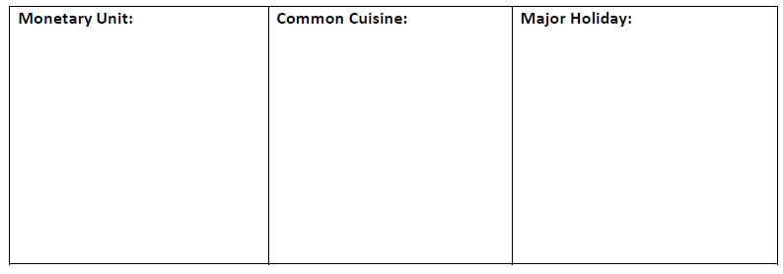
Reference Guide for Everyday Information
Use World Almanac and Book of Facts AND either the
Worldmark Encyclopedia of Nations OR Worldmark
Encyclopedia of Cultures and Daily Life to
complete chart
create reference guide
attach original proof

Slide 9
Pass Code for Future Residence
find interesting book of your choice about country and mark the pass code for entrance to residence
make a copy of p. 15
highlight the 6th word in the 4th line to mark pass code

Slide 10
Annotated Article Regarding Economic Situation
print magazine article about country’s
economic conditions using Gale Expanded
Academic ASAP and
HIGHLIGHT and ANNOTATE (write) topic, main idea, major supporting details
NOTE: article should be less than three years old

Slide 11
Important Documents
HOP pgs. 19, 28-30

Slide 12
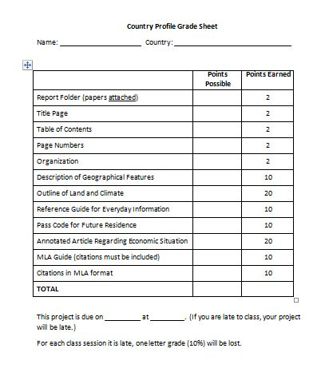

Slide 13
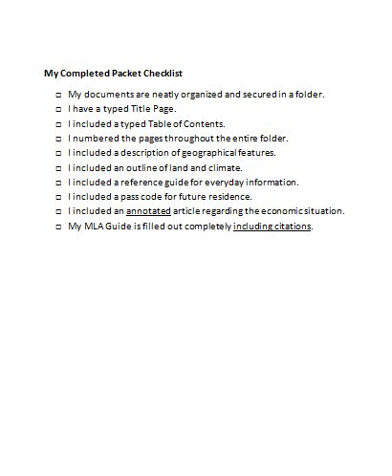

Slide 14
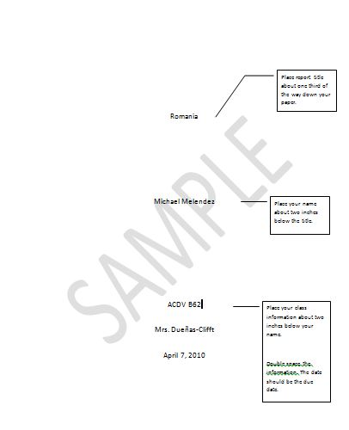

Slide 15
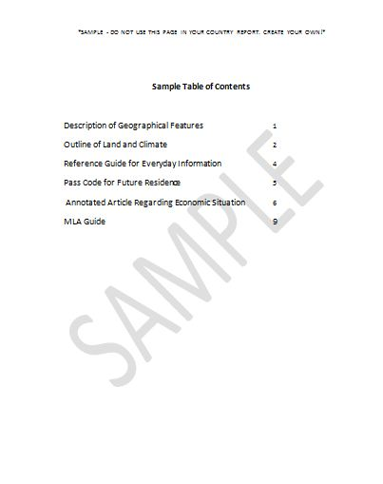

Slide 16
MLA – Modern Language Association

Slide 17
Reasons for Using MLA
establish credibility
avoid plagiarism
stealing and passing off ideas/words of another as one's own
using another's ideas/words without crediting the source
to present as new and original an idea or product derived from an existing source
(adapted from www.plagiarism.org)

Slide 18
MLA Style: Two Parts
Works Cited Page
Parenthetical Citations

Slide 19
Works Cited Page
complete list of sources used in paper/project
provides information necessary for reader to locate and retrieve information used in your paper/project

Slide 20
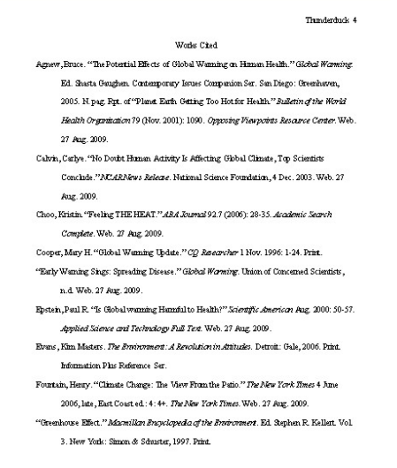

Slide 21
Works Cited Page
Most citations contain
Author’s name
Title of work
Publication information
… (see HOP pgs. 25 – 27)

