Slide 1
Literary Elements
“The Lottery” by Shirley Jackson

Slide 2
Literary Terms
words used in discussion, criticism, and analysis of novels, poetry and other works of literature
Setting
Protagonist
Antagonist
Conflict
Plot
Climax
Resolution
Point of view
Theme

Slide 3
Setting
Time and location in which the story takes place
Question:
What is the setting of “The Lottery”?

Slide 4
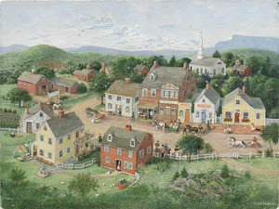
Setting – “The Lottery”
a small village on a sunny summer’s day
sometime between 10 a.m. and noon

Slide 5
Protagonist
Main character
“Hero” of the book
Question:
Who is the protagonist in “The Lottery”

Slide 6
Protagonist – “the Lottery”
Tessie Hutchinson
unlucky loser of the lottery
forgetful
selfish
a little different from the other villagers

Slide 7
Antagonist
“Force” that works against main character
Person
Illness
Death
Question:
Who is the antagonist in
“The Lottery?

Slide 8
Antagonist – “The lottery”
the lottery and with it the tradition the villagers hang on to

Slide 9
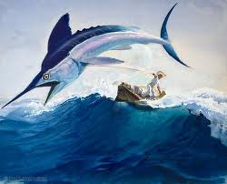
Conflict
What the main character tries to overcome throughout the story
Person vs. person
Person vs. self
Person vs. nature
Person vs. society
Person vs. God
Question:
What is the main conflict
in the story “The Lottery”?

Slide 10
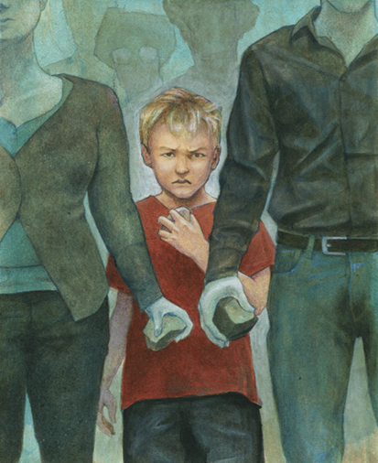
Conflict – “the lottery”
Internal (takes place in the person’s mind)
is not revealed in the story
External (takes place when person/group struggles against other force)
true struggle is against tradition - whether or not they/their family members will die each year

Slide 11
Plot
Events that make up a story
How they relate
Usually in chronological order
Homework: Complete the plot map for “The Lottery”.

Slide 12
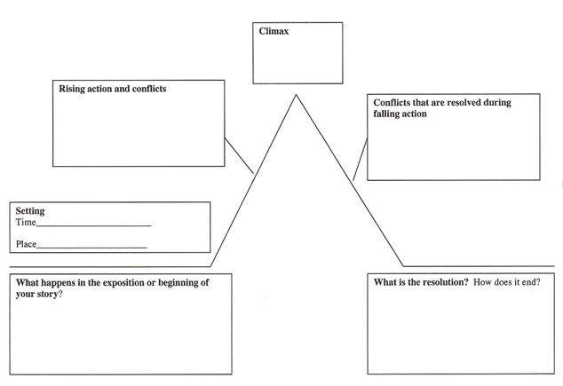
Plot Chart

Slide 13
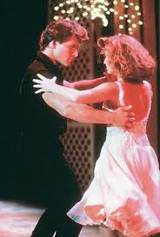
Climax
turning point of the story
point of highest tension/greatest emotional intensity
point which marks a change (for the better or the worse) for the main character
SPOILER ALERT – movies

Slide 14
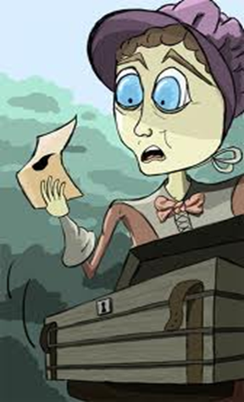
Climax – “The lottery”
Tessie chooses the paper with the black dot and is the lottery winner.

Slide 15
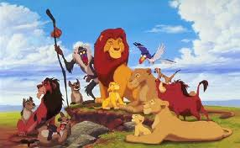
Resolution
part of the story's plot line in which the problem of the story is resolved

Slide 16
Resolution – “The lottery”
The villagers stone Tessie.

Slide 17
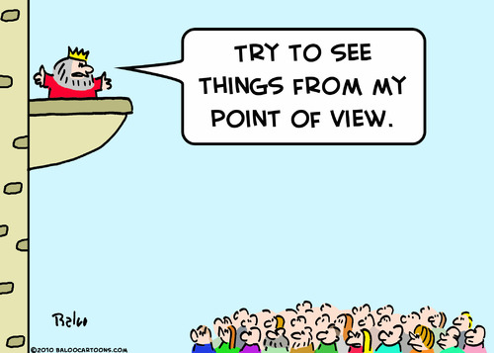
Point of View
stand point from which the story is told
First person
Third person
Question: (you guessed it… ) What is the point of of view in “The Lottery”?

Slide 18
Theme
Life lesson, meaning, moral, or message about life or human nature that is communicated by a literary work
Themes are not explicit; they are implied.
They involve concepts about life, people, the human condition, and other broad, philosophical ideas.

Slide 19
Themes – “The lottery”
Theme 1: The reluctance of people to reject outdated traditions, ideas, rules, laws, and practices. villagers continue the lottery year after year because, as one of the villagers would say, “We have always had a lottery as far back as I can remember. I see no reason to end it.” | Theme 2: The wickedness of ordinary people can be just as horrifying as the heinous crime of a serial killer or a sadistic head of state. From time to time, we are surprised to learn that the man, woman, or even child next door–a quiet, unassuming postal worker, bank clerk, or student–has committed offenses so outrageous that they make national news. | Theme 3: Following the crowd can have disastrous consequences. Although some townspeople raise questions about the lottery, they all go along with it in the end. Thus, they become unthinking members of a herd, forfeiting their individuality and sending Tessie Hutchinson to her death.

