Slide 1
Patterns of organization
Chapter 4

Slide 2
Blue Book Entry
What would be different about the way you would tell someone how to make spaghetti and the way you would tell someone about the several types of spaghetti?

Slide 3
Patterns of Organization
The way an author organizes major details to support his claim (main idea)
Also called THINKING PATTERNS or THOUGHT PATTERNS

Slide 4
Benefits of Recognizing Patterns of Organization
Improved reading comprehension by predicting information author will present
Improved writing skills by using patterns in your own writing
Improved test-taking skills

Slide 5
Common Patterns
Definition and Example
Classification
Sequence of Events/Process
Comparison and Contrast
Cause and Effect
Listing or Enumeration
Notes:
Introductory notes.

Slide 6

Definition and Example
Term
Definition
Example(s)
Example: Responsibility is the quality of being able to fulfill one’s obligations. For example, the ability to find a way to pay for rent and utilities is a renter’s responsibility.
Notes:
A list of procedures and steps, or a lecture slide with media.

Slide 7
Signal Words and Phrases
Definition and Example(s)
refers to
is
for example
also called
means
can be defined as
Write down some of these words on HOP pg. 15
*Hint - See also pg. 140

Slide 8
Let’s Apply
pgs. 122 – 123
  Applied Psychology
  Activity 4.1

Slide 9
Classification
used when grouping/dividing concepts into major types, categories, classes, or parts based on common characteristics
Example: There are three types of popular music, rock, pop, and hip-hop. Rock…
Notes:
A list of procedures and steps, or a lecture slide with media.

Slide 10
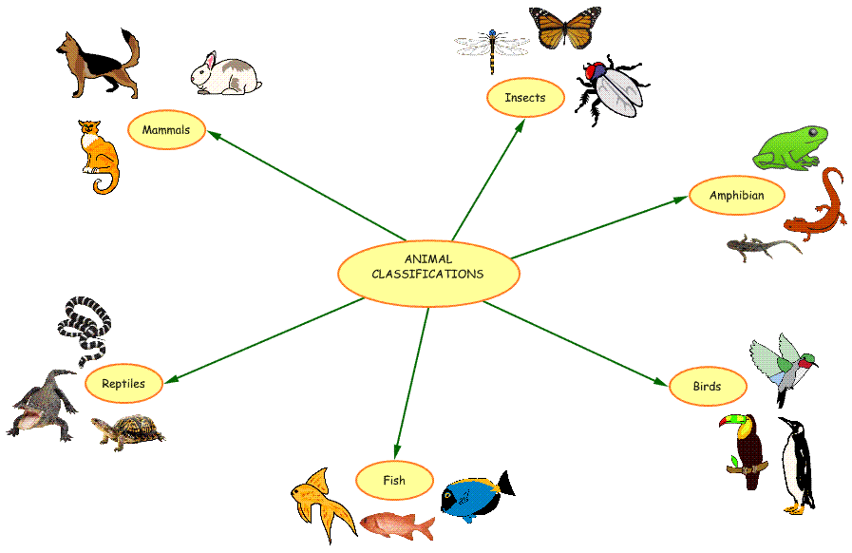
Classification – Concept Map
Notes:
A list of procedures and steps, or a lecture slide with media.

Slide 11
Signal Words and Phrases
Classification
divide groups into
can be classified by
one type
another kind
composed of
several categories
types
Write down some of these words on HOP pg. 15
*Hint - See also pg. 140

Slide 12
Let’s Apply
pg. 124
  Sociologists divide

Slide 13
Sequence of Events/Process
used when authors want to present events, stages, or a process, step by step in a specific order
Example: Making spaghetti involves three simple steps. First…
Notes:
A list of procedures and steps, or a lecture slide with media.

Slide 14
Signal Words and Phrases
Sequence of Events/Process
steps
next
then
before
final stage
after
Write down some of these words on HOP pg. 15
*Hint - See also pg. 140

Slide 15
Sequence of Events/Process– Concept Map
first
boil salt water
next
add pasta and cook for 7 – 9 minutes
finally
drain water and enjoy
Notes:
A list of procedures and steps, or a lecture slide with media.

Slide 16
Let’s Apply
pgs. 126 – 128
  In 1607, three ships,…
  Activity 4.3 (1 OR 2)

Slide 17
Blue Book Entry 2/16/12
What are three patterns of organization we have discussed so far?
What are a few transition words that can help you recognize each pattern?

Slide 18
Comparison and Contrast
used when authors want to discuss the similarities AND/OR differences between or among people, places, ideas, or events
Example: Making spaghetti involves three simple steps. First…
Notes:
A list of procedures and steps, or a lecture slide with media.

Slide 19
Comparison and Contrast
comparison
contrast
comparison and contrast
Notes:
A list of procedures and steps, or a lecture slide with media.

Slide 20
Comparison
used when authors want to discuss the similarities between or among people, places, ideas, or events
Example: There are several similarities between the Civil War and the war in Iraq. Both…
Notes:
A list of procedures and steps, or a lecture slide with media.

Slide 21
Signal Words and Phrases
Comparison
similarities among
both
like
as well as
Write down some of these words on HOP pg. 16
*Hint - See also pg. 140

Slide 22
Let’s Apply
pgs. 129
  Similarities Between High School…

Slide 23
Contrast
used to emphasize the differences between or among people, places, ideas, or events
Example: There are several distinct differences between primates and humans.
Notes:
A list of procedures and steps, or a lecture slide with media.

Slide 24
Signal Words and Phrases
Contrast
differences
on the other hand
differ
in contrast
unlike
while
than
Write down some of these words on HOP pg. 16
*Hint - See also pg. 140

Slide 25
Let’s Apply
pgs. 130-131
  Differences Between High School…

Slide 26
Comparison and Contrast
used to present both similarities and differences between or among people, places, ideas, or events
Example: High school and college students are not as different as one might expect.
Notes:
A list of procedures and steps, or a lecture slide with media.

Slide 27
Comparison and Contrast
Concept Map
Similarities between both
High School Students (differences)
College Students (differences)

Slide 28
Comparison and Contrast
Concept Map
Attributes | High School Students | College Students
Courses | limited selection | wide selection
Fees | free | expensive
Motivation | essential for success | essential for success
Level of Stress | … | …

Slide 29
Let’s Apply
pgs. 132-133
  Comparing and Contrasting High School…
  Activity 4.4 (1 OR 2)

Slide 30
Cause and Effect
used to explain the causes (events or actions) that led to a particular effect (result)
also used to explain the effects (results) of a particular cause (event or action)
Notes:
A list of procedures and steps, or a lecture slide with media.

Slide 31
Cause and Effect
Causes answer the question: “Why did something happen?”
When effects are emphasized, they answer the questions “What happened as a result of this event? OR “What can happen?”
Notes:
A list of procedures and steps, or a lecture slide with media.

Slide 32
Signal Words and Phrases
Sequence of Events/Process
as a result
therefore
due to
consequently
led to
because of
caused
Write down some of these words on HOP pg. 16
*Hint - See also pg. 140

Slide 33
Many Causes - One Effect
Concept Map
I decided to take college courses
I lost my job
My children are grown
I fell in love with nursing
Notes:
A list of procedures and steps, or a lecture slide with media.

Slide 34
One Cause – Many Effects
Concept Map
Cause: Regular excessive drinking
Effect 1: poor academic performance
Effect 2: Health problems
Effect 3: Relationship conflicts
Notes:
A list of procedures and steps, or a lecture slide with media.

Slide 35
Let’s Apply
pgs. 135 – 137
  On September 11, 2001, nineteen terrorists…
  Activity 4.5 (1 OR 2)

Slide 36
Listing or Enumeration
used when authors want to present a number of details or items in any order
sometimes, authors use bullets, letters, or numbers to list their ideas
Example: There are three major benefits of reading regularly. First,… (note that the order in which the benefits are presented is not important)
Notes:
A list of procedures and steps, or a lecture slide with media.

Slide 37
Listing or Enumeration – Concept Map
Benefits of Regular Reading
increased vocabulary
hundreds of new terms in context
visual clues
knowledge about the world
newspaper
magazines
improved job chances
interview questions about general knowledge
…
Notes:
A list of procedures and steps, or a lecture slide with media.

Slide 38
Signal Words and Phrases
Listing or Enumeration
several ways
second guideline
another
one reason
three things
Write down some of these words on HOP pg. 16
*Hint - See also pg. 140

Slide 39
Let’s Apply
pgs. 138 – 139
  Would you like to …
  Activity 4.6 (1 OR 2)

Slide 40
Combined Patterns
in textbooks, authors often combine patterns to get their ideas across
HOWEVER, one pattern usually dominates

Slide 41
Recognizing Combined Patterns
Questions to ask:
What is the topic?
What kind of information does the author want me to learn most?
What does the main idea say about that information?

Slide 42
Let’s Apply
pgs. 144 – 145
  Many children who become… (#1-4)

Slide 43
Homework
pgs. 141 – 142
  Memory Check 1: How much do you remember?
  Activity 4.7
Pg. 145
  Memory Check 2: How much do you remember?
MRL – Pattern Organization – Cause and Effect

