Slide 1
TC. Ch. 26 Stress and Health

Slide 2
What is Stress?
...our physiological and mental response to situations that threaten or challenge us and that require some kind of adjustment.

Slide 3
What is the SRRS?
Social Readjustment Rating Scale created by Holmes and Rahe
Measures stress by ranking positive and negative life events from most to least stressful

Slide 4
How stressed are you?
Pg. 278
check all the events that have happened to you in the last year
add up the points

Slide 5
What are Daily Hassles?
Little stressors, like annoying daily demands, that according to Lazarus cause more stress than the major life changes (events mentioned on the SRRS)

Slide 6
What are Uplifts?
Positive occurrences in life that may reduce the effect of many hassles

Slide 7
Approach-Approach Conflict
Having to choose between two desirable or positive alternatives
choosing between two great job offers

Slide 8
Avoidance-Avoidance Conflict
Being forced to choose between two negative or undesirable alternatives
choosing between going to the dentist or a toothache
NOT choosing may be impractical or detrimental

Slide 9
Approach-Avoidance Conflict
Being attracted and repelled by the same choice, which has both desirable and undesirable features
You want to get a tattoo but are afraid of needles

Slide 10
Try it!
In groups, create a concept map of the three types of conflict (pgs. 277-278). Include your own examples (not in book or from me) of each type of conflict.

Slide 11
Lack of Control
Unpredictable stressors are more stressful and more difficult to cope with than predictable
No chance to prepare
No power to do something about the stressor

Slide 12
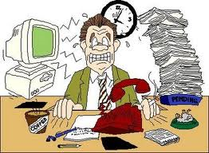
Bluebook Entry: Stress in the Workplace
Take two minutes to write aspects of work that are stressful (workplace stressors)

Slide 13
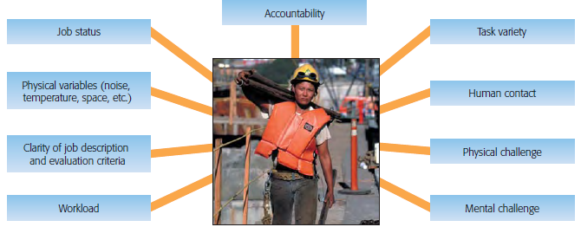
Variables in Work Stress

Slide 14
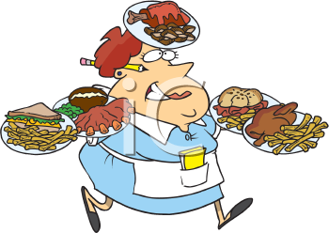
Stress in the Workplace
Which of the nine work stress
variables do you think cause the
most stress for restaurant servers?

Slide 15
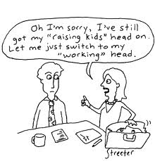
Women and Work Stress
Gender-specific stressors
Gender discrimination
Sexual harassment
Combining work and family roles

Slide 16
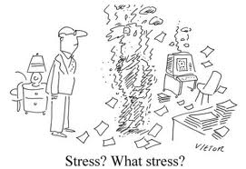
Effects of Job Stress
Reduced effectiveness
Absenteeism
Tardiness
Accidents
Substance abuse
Lower morale
“Burn-Outs”

Slide 17
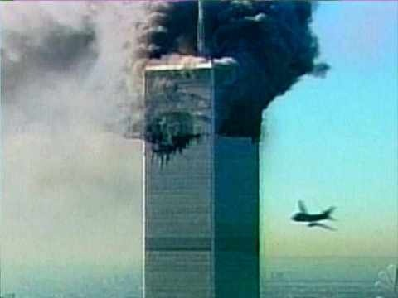
Catastrophic Events
May cause Post-traumatic stress disorder (PTSD)
Prolonged and severe stress reaction or severe chronic stress

Slide 18
Symptoms of PTSD
Flashbacks
Nightmares
Increased anxiety
Survivor guilt
They lived while others died
Depression
Alcohol problems

Slide 19
Racism and Stress
Historical Racism – source of stress experienced by members of groups that have a history of oppression
African Americans
Possible Effects: high blood pressure

Slide 20
Quick Write
What are three types of conflict? Define them.

Slide 21
Responding to Stress

Slide 22
Theories of Stress Responses
Selye’s general adaptation syndrome
Lazarus’s cognitive theory
Coping strategies

Slide 23
General Adaptation Syndrome
Introduced by Hans Selye, “father of stress research”
G.A.S. – predictable sequence of reactions (alarm, resistance, exhaustion stages) in response to stressors
TIPS: Use acronyms to memorize lists. GAS and ARE

Slide 24
General Adaptation Syndrome
Stressor
...a demand placed on the body that requires adjustment and brings about the stress reaction.
G. A. S.
3 Stages:
1. Alarm
2. Resistance
3. Exhaustion
Healthy Adaptation or Illness

Slide 25
Stage 1: Alarm Stage
“Fight or Flight” reaction: body mobilizes resources to combat threat by
activating the parasympathetic nervous system, which releases hormones (Glucocorticoids) to supply body with instant energy

Slide 26
Stage 2: Resistance Stage
Adrenal cortex continues to supply body with hormones (Glucocorticoids) to resist stressors or adapt to stressors

Slide 27
Stage 3: Exhaustion Stage
Body fails to resist or adapt to stressors
Depletion of all energy resources
Results in diseases, disorders and death

Slide 28
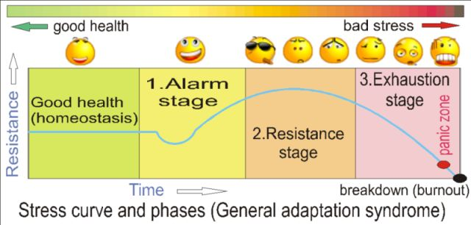

Slide 29
Harmful Effects of Stress
extended release of glucocorticoids leads to
Permanent increase in blood pressure
Suppression of immune system
Weakening of muscles
Damage of the hippocampus
CHRONIC DISEASES

Slide 30
Lazarus’s Cognitive Therapy
Stressor
Selye assumed
that stress is caused by the stressor itself.
Lazarus proposed that a person’s perception determines whether stress occurs.
Appraisal
G. A. S.
Healthy Adaptation or Illness

Slide 31
Lazarus and Folkman’s Theory
Stressor
Primary Appraisal: Is stressor negative, positive, or neutral?
Appraised as stressful could involve:
Harm or loss - has already occurred
Threat – potential harm or loss
Challenge – opportunity to grow
No Stress
Yes
No (positive, irrelevant)
Secondary Appraisal: Can I control the situation?
1. Evaluation of Resources:
Physical (health, energy, stamina)
Social (support, network)
Psychological (skills, morale, self-esteem)
Material (money, tools, equipment)
Time
2. Considering Options in dealing with stressor
If Yes:

Slide 32
Coping Strategies
Coping – person’s efforts through action and/or thought to deal with perceived stressors
Problem-focused coping
Emotion-focused coping

Slide 33
Problem-Focused Coping
Direct
Consists of reducing, modifying, or eliminating the SOURCE of stress

Slide 34
Emotion-Focused Coping
Reappraisal of the stressor to reduce emotional impact
Humor
Meditation
Journaling
Ignoring the stressor (effective)

Slide 35
Example of Combination
A college student faces multiple final examinations. She knows she must get top grades in order to have a chance at acceptance to graduate school and is very stressed out by the situation. She could organize a study group or get right to work on studying systematically (problem-focused coping). Or she could decide that she needs to relax and give herself a short break in which to decompress (emotion-focused coping) before she can come up with a study plan (problem-focused coping).

Slide 36
Proactive Coping
Efforts or actions one takes before a potentially stressful situation to prevent its occurrence or to lessen its consequences

Slide 37
Try it!
In groups, create a concept map of the three types of coping (pgs. 285-286). When would you use each type of coping strategy?

Slide 38
Coronary Heart Disease
Leading cause of death in the United States
Risk Factors
Modifiable (changeable)
Sedentary lifestyle
High serum cholesterol level
Cigarette smoking
obesity
Not modifiable (unchangeable)
Family history

Slide 39
Personality Type
Associated with an individual’s risk of heart disease
Meyer Friedman and Ray Rosenman conclude two types of personality – Type A and Type B
Try It 26.2 (p. 292)

Slide 40
Personality Type
Type A
Strong sense of time urgency
Impatient, excessively competitive, hostile, easily angered
Type B
Relaxed, easygoing, not driven by sense of time urgency
not impatient or hostile, able to relax without guilt

Slide 41
Personality Types and Stress
Which personality type do you think is more likely to develop coronary heart disease and ill health in general?
Why?

Slide 42
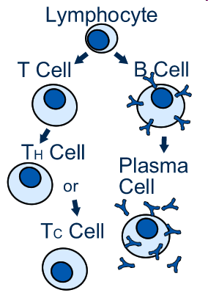
Immune System and Stress
Key Components of Immune System
Lymphocytes – consist of B and T Cells
Certain viruses attack T Cells

Slide 43
Immune System
Psychological factors, emotions, and stress all impact the immune system

Slide 44
Personal Factors that Reduce the Impact of Stress and Illness
Optimism
Hardiness
Religious Involvement
Social Support
TIP!
Use acronyms to memorize lists.
e.g. HORS

Slide 45
Try it!
In groups, make an outline of pgs. 294-295. Describe how each personal factor has a positive impact on health!

Slide 46
Optimism
Generally expect good outcomes
Cope more effectively with stress
Makes them more stress-resistant

Slide 47
Hardiness
3 psychological characteristics
Commitment – strong sense of commitment to work and personal life
Control – see themselves as in control – no victim attitudes
Challenge – see challenges as opportunities for growth

Slide 48
Religious Involvement
Study showed frequent church attendance correlated w/better health
Why does it improve health?
Positive emotions
Stronger social support

Slide 49
Social Support
Can include tangible aid, information, advice, and emotional support
Includes feeling of being loved, valued, and cared for
Has positive effects on immune system
Encourages health promoting behaviors and discourages negative ones
Reduced depression

Slide 50
Gender and Health
Gender Gap
Middle-aged women = higher postsurgical mortality rate than men
Women are slighted in general health care and treatment

Slide 51
Ethnicity & Health
Most minorities have more health problems
Rates of diabetes dramatically higher among Native Americans
Asian Americans – overall age-adjusted death rate is 40% lower than for white American males, but their death rate from stroke is 8% higher

Slide 52
Homework
Cornell Notes – pgs. 240-243
Algernon Book Report
Bring ScanTron, #2 pencil, extra credit flashcards

Slide 53
Lifestyle and Health
What do you think is the greatest threat to your personal well-being and longevity?
Health enemy #1 = your own habits!

Slide 54
Smoking and Health
#1 cause of preventable death in the U.S.
Nonsmokers who are regularly exposed to secondhand smoke have twice the risk of heart attack of those who are not exposed
There is hope for smokers! ☺ Average smoker makes five or six attempts of quitting before succeeding

Slide 55
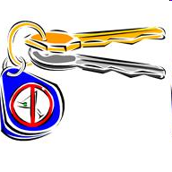
Alcohol Abuse
Ravages all body’s organs
Increases risk of heart disease and several types of cancer
Damages brain
Nearly ½ all traffic fatalities are related to alcohol
If you’re going to drink – PLEASE don’t drive! ☺

Slide 56
Benefits of Exercise
Increases heart efficiency
Raises HDL (good blood cholesterol) and reduces LDL (bad cholesterol)
Burns extra calories (lose and maintain weight)
Makes bones denser and stronger
Moderates effects of stress
Gives you more energy, less fatigue
Benefits immune system (increases natural killer cell activity)

Slide 57
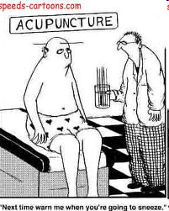
Alternative Medicine
Any treatment or therapy that has not been scientifically demonstrated to be effective
Is taking vitamin C to prevent scurvy alternative medicine?
Is taking vitamin C to protect yourself against a cold alternative medicine?

Slide 58
Why do people use alternative medicine?
Easier to take a vitamin than make a lifestyle change
People who do their own research about alternative medicine may find an effective treatment
No health insurance
Want to avoid negative effects of drugs

Slide 59
What is a danger of alternative medicine?
People neglect to tell their physicians
Risky = some alternative medicine can interact with prescription drugs
Faith in alternative medicine may result in delay of seeking necessary conventional medicine

Slide 60
Homework
HOP pgs. 49-50 Create a TC Ch. 5 Practice Test w/answer key (the answer key must include answers to the short answer questions)

